Slide 1
Introduction to Big Data
Recommender System
ITC6001A1
PROF: Dr.Dimitrios Vogiatzis

Slide 2
Book-Crossing Dataset
The Book-Crossing datadet contains 3 tables:
BX-Users
BX-Books
BX-Book-Ratings

Slide 3
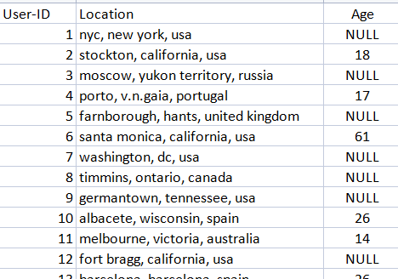
BX-Users
BX-Users contains info about the users:
User-ID
Location
Age

Slide 4
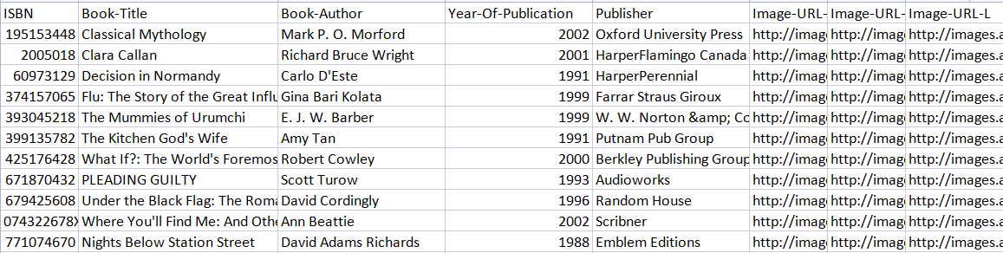
BX-Books
BX-Books contains info about the Books and Authors:
ISBN
Book-Title
Book-Author
Year-Of-Publication
Publisher
Image-URL-S
Image-URL-M
Image-URL-L

Slide 5
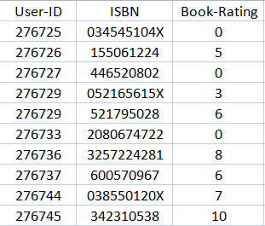
BX-Book-Ratings
BX-Book-Ratings contains the Book_ids and the user ratings:
User-ID
SBN
Book-Rating

Slide 6
Info about our data
The size of the 3 tables combines is 934024
The mean average of teh Ages is 36 yo
The number of unique books is 2484
The number of unique Authors is 1777
The number of users is 17296

Slide 7
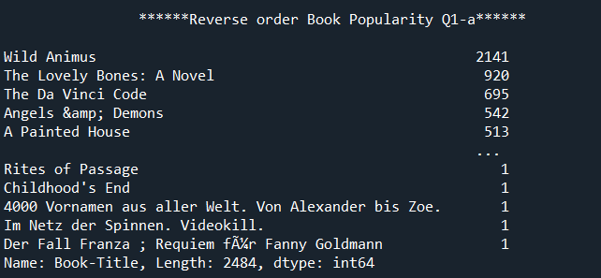
Book Popularity
Info about our data
The 3 most popular books are:
Wild Animus
The Lovely Bones: A Novel
The Da Vinci Code

Slide 8
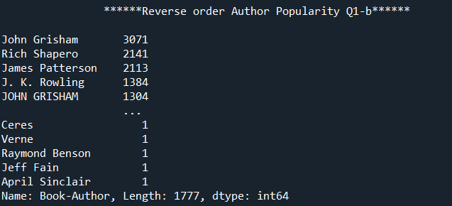
Info about our data
Author Popularity
The 3 most popular books are:
Wild Animus
The Lovely Bones: A Novel
The Da Vinci Code

Slide 9
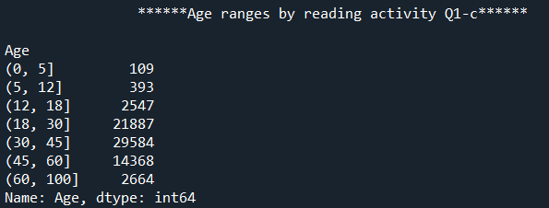
AGE ranges by reading activity
The age ranges with the highest reading activity are:
30-45
18-30
45-60

Slide 10
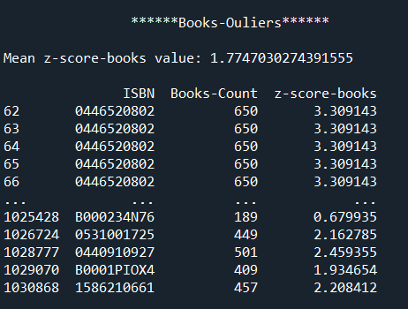
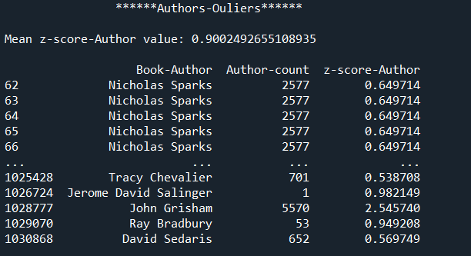
Outliers(z-score)
1) Books_Outliers: z-score>0.48
2) Authors_Outliers: z-score>0.3

Slide 11
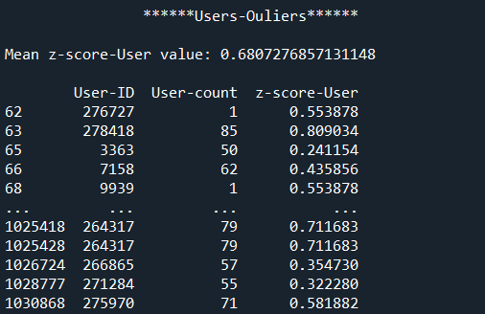
Outliers(z-score)2
3) Users_Outliers: z-score>0.2

Slide 12
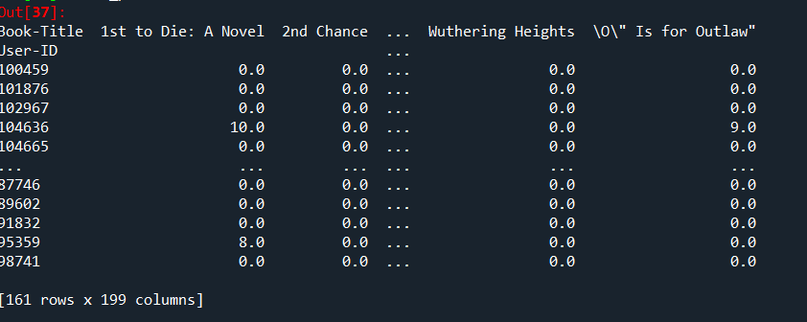
There are only 161 users who read more than 68 books andthere are only 199 books that have more than 40 ratings

Slide 13
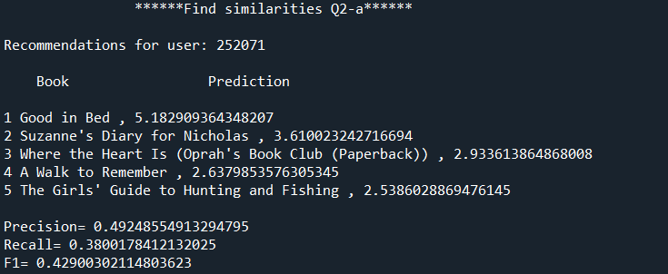
Recommender System-Similarities

Slide 14
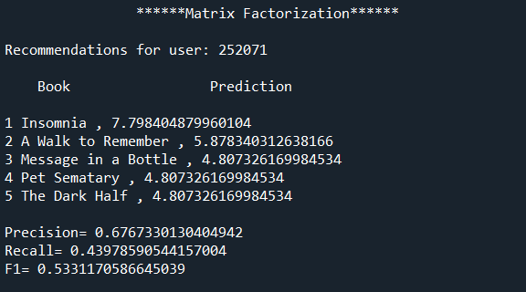
Matrix Factorization

Slide 15
Introdaction to Big Data

Slide 17
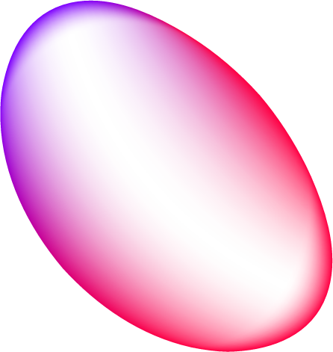

Table of contents
Our company
Our services
01
02
Our clients
Projection
03
04
You can describe the topic of this section
You can describe the topic of this section
You can describe the topic of this section
You can describe the topic of this section

Slide 18
About us
You can give a brief description of the topic you want to talk about here. For example, if you want to talk about Mercury, you can say that it’s the smallest planet

Slide 19
01
Our company
This is the subtitle that makes it comprehensible

Slide 20
Our commitments
Commitments to science
Commitments to our clients
Mercury is the closest planet to the Sun and the smallest one in the entire Solar System
Jupiter is the biggest planet and the fourth-brightest object in the night sky

Slide 21
Our history
Jupiter is the biggest planet in the Solar System
Despite being red, Mars is a very cold place
Jupiter
Mars
2005
2008
2010
Venus
Venus is the second planet from the Sun

Slide 22
Our history
Earth is the planet where we all live
Earth
2012
2016
And still
counting!
Saturn
Saturn is a gas giant and has several rings

Slide 23
— Someone Famous
This is a quote, words full of wisdom that someone important said and can make the reader get inspired”

Slide 24
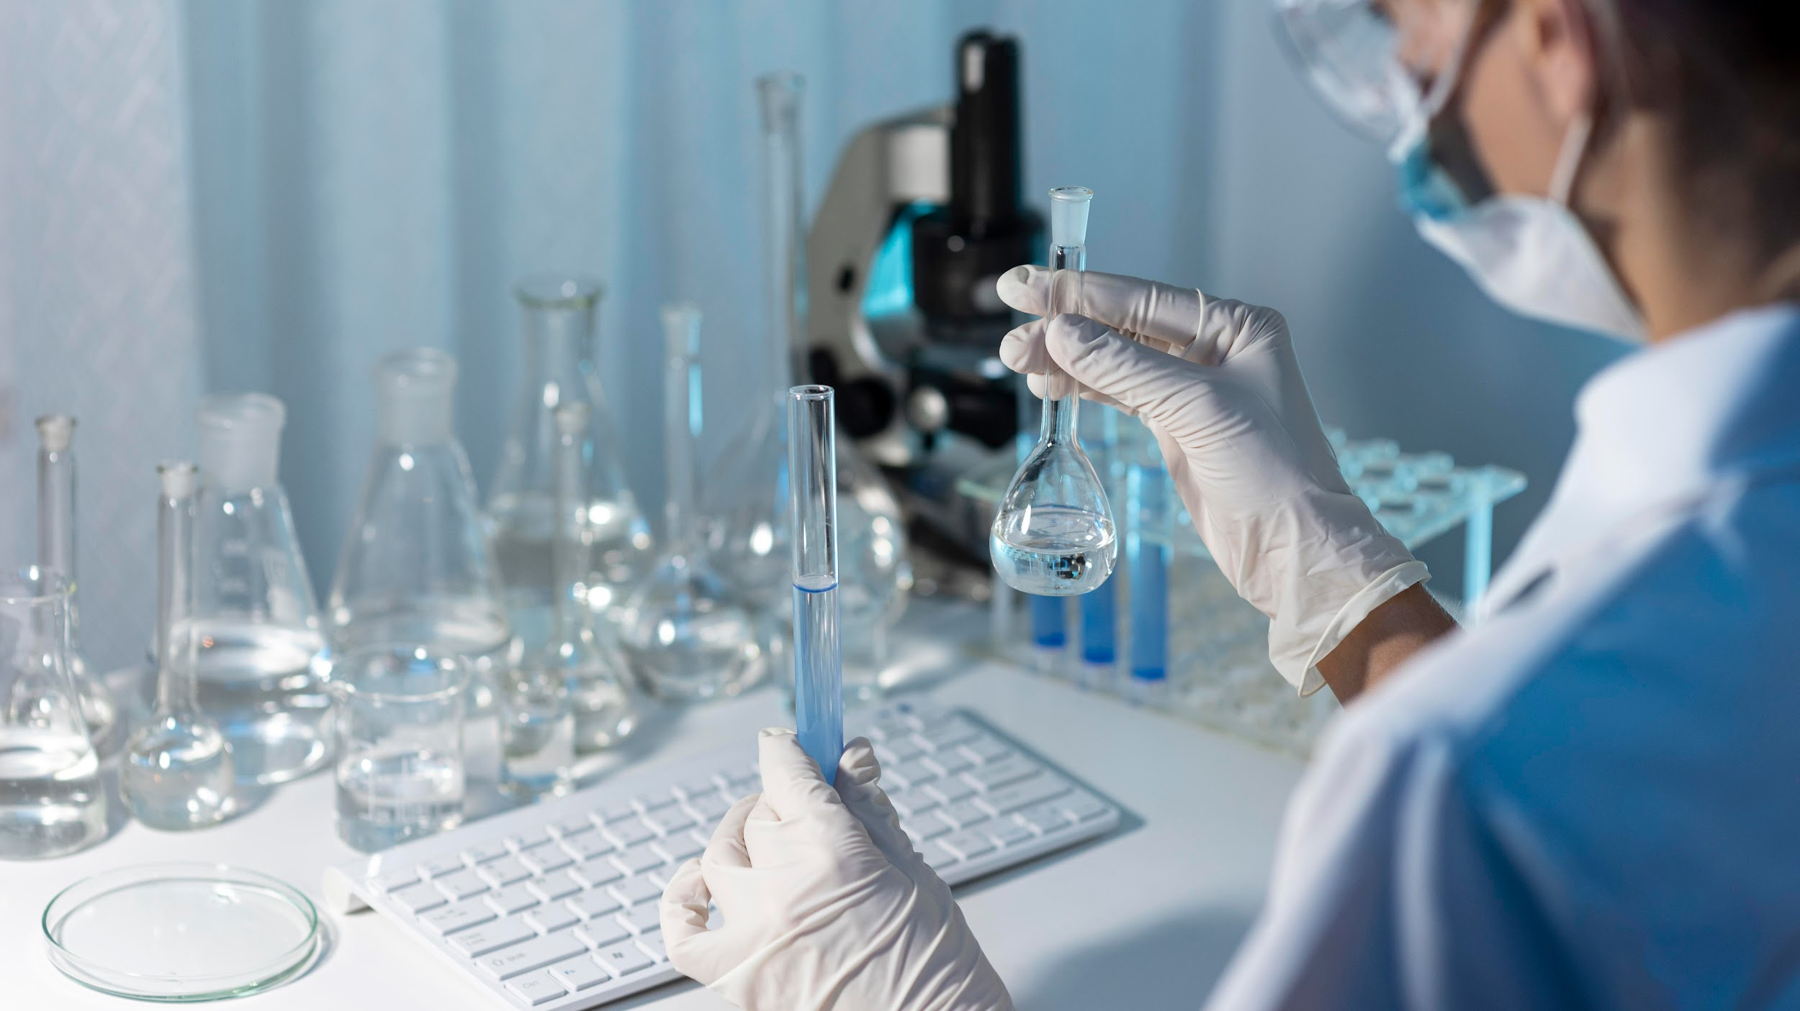
A picture is worth a thousand words

Slide 25
Our philosophy
Mision
Vision
Values
Despite being red, Mars is actually a cold place. It’s full of iron oxide dust
Jupiter is the biggest planet in the Solar System and it’s also a gas giant
Mercury is the closest planet to the Sun and the smallest one in the Solar System

Slide 26
13,102,019
Big numbers can catch your audience’s attention

Slide 27
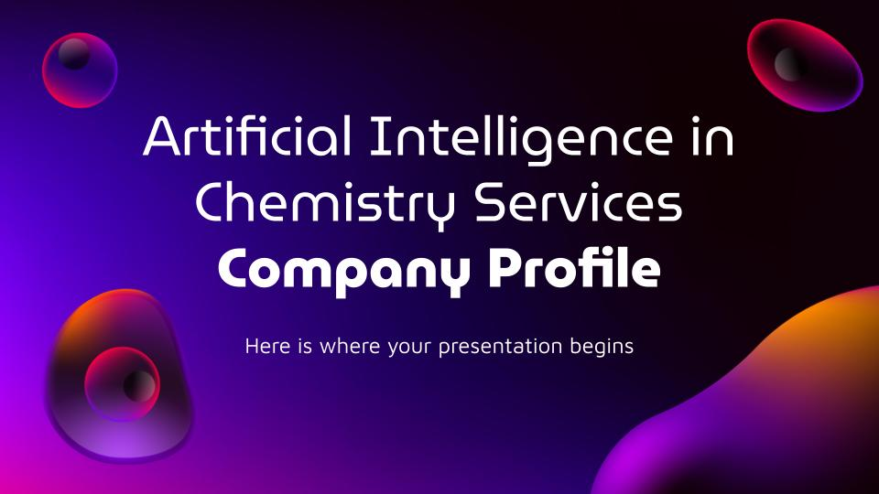
Our website
You can replace the image of the screen with your own work. Just delete this one, add yours and center it properly

Slide 28
Our objectives
Objective | Progress | Deadline
Mercury |  | 04/2022
Mars |  | 06/2022
Jupiter |  | 10/2022
Venus |  | 12/2022
90%
64%
50 %
30%

Slide 29
Locations
Mercury
It’s the closest planet to the Sun
Venus
It’s the second planet from the Sun
Saturn
Saturn is a gas giant and has rings

Slide 30
Our services
Saturn
Neptune
Jupiter
Venus
Mars
Mercury
Saturn is a gas giant and has several rings
Neptune is the farthest planet from the Sun
Jupiter is the biggest planet in the Solar System
Venus is the second planet from the Sun
Despite being red, Mars is a cold place not hot
Mercury is the closest planet to the Sun

Slide 31
Best sellers
Mercury is the closest planet to
the Sun
Neptune is the farthest planet from the Sun
Despite being red, Mars is actually a cold place
01
02
03

Slide 32
Our strengths
Loyalty
Efficiency
Reliability
Commitment
Neptune is the farthest planet from the Sun
Mercury is the closest planet to the Sun
Jupiter is the biggest planet of them all
Despite being red, Mars is a cold place not hot

Slide 33
333,000
9h 55m 23s
386,000 km
The Sun’s mass compared to Earth’s
Jupiter’s rotation period
Distance between Earth and the Moon

Slide 34
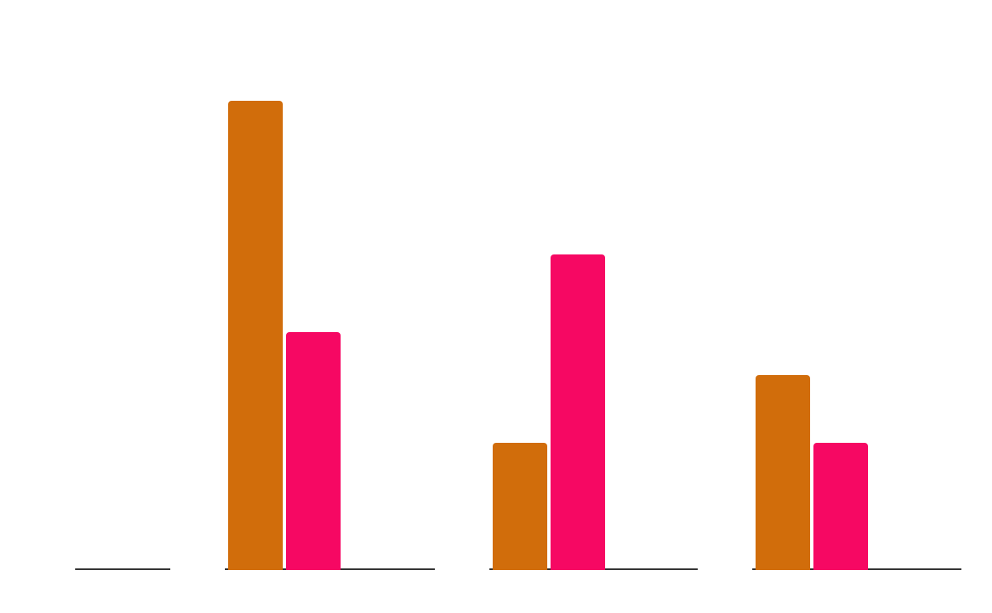
Our growth
Mercury
It’s the closest planet to the Sun
Venus
It’s the second planet from the Sun
Mars
2019
2020
2021
Mars is actually a very cold place
Follow the link in the graph to modify its data and then paste the new one here. For more info, click here

Slide 35
Customer profile
Gender
Age
18 - 35
80%
36 - 60
25%
25%
75%
Interests
25%
50%
90%
Mercury is the smallest planet
Mars is actually a cold place
Venus has a beautiful name

Slide 36
Our numbers
Budget
80%
50%
70%
Sales
People
Market
Neptune is far away from us
Mars is a really cold place
Jupiter is the biggest planet
$28.87
30 days
45 labs
77 units
Avg. price per unit
Avg. days on market
Retailers
Remaining inventory

Slide 37
Future projects
Venus is the second planet from the Sun
Mercury is the closest planet to the Sun
Project 1
Project 3
01
02
03
04
Project 2
Project 4
Despite being red, Mars is a very cold place
Jupiter is a gas giant and the biggest planet

Slide 38
Customers testimonials
Jane Thorne
James Jones
Laura Reid
“Despite being red, Mars is a very cold place. The planet is full of iron oxide dust”
“Mercury is the closest planet to the Sun and the smallest one in the Solar System”
“Venus has a beautiful name and is the second planet from the Sun. It’s terribly hot”

Slide 39
Awards
Venus
Mars
Mercury
Saturn
Neptune
Venus is the second planet from the Sun. It’s really hot there
Despite being red, Mars is actually a cold place, not hot
Mercury is the closest planet to the Sun and the smallest one
Saturn is a gas giant mostly composed of hydrogen and helium
Neptune is the farthest planet from the Sun

Slide 40
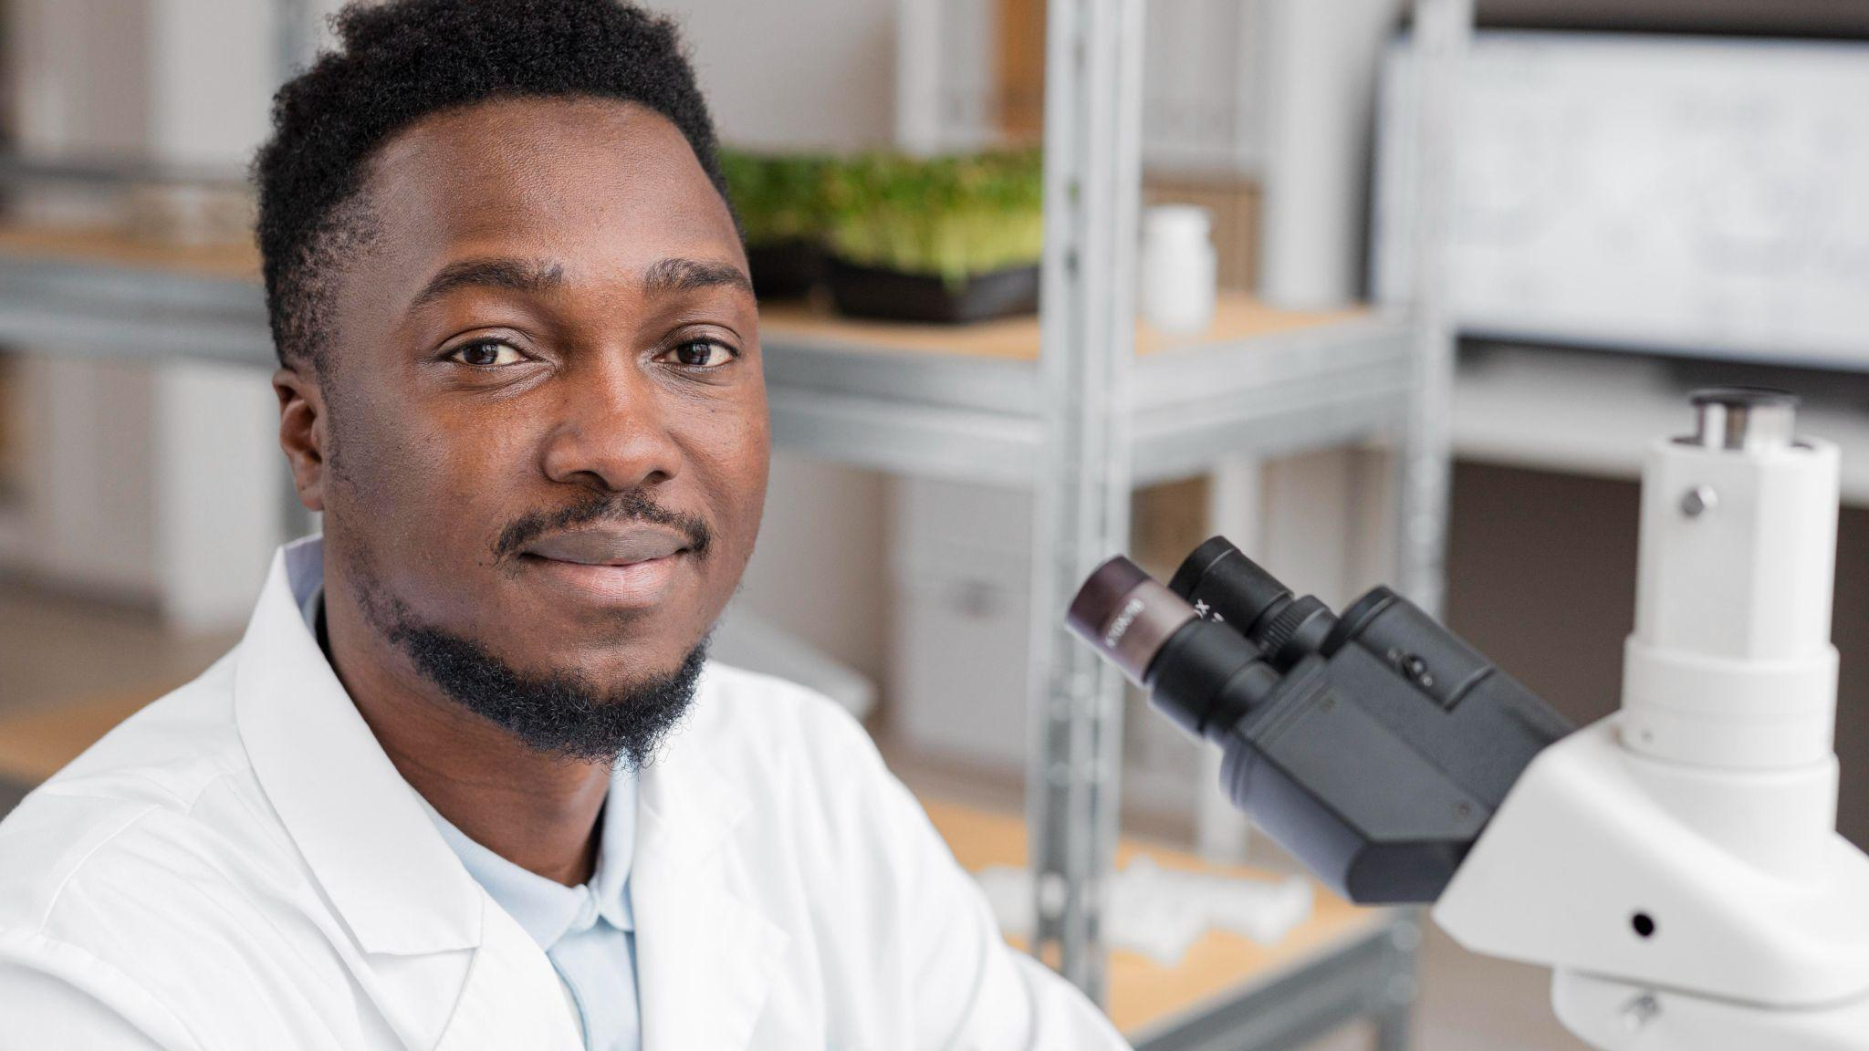
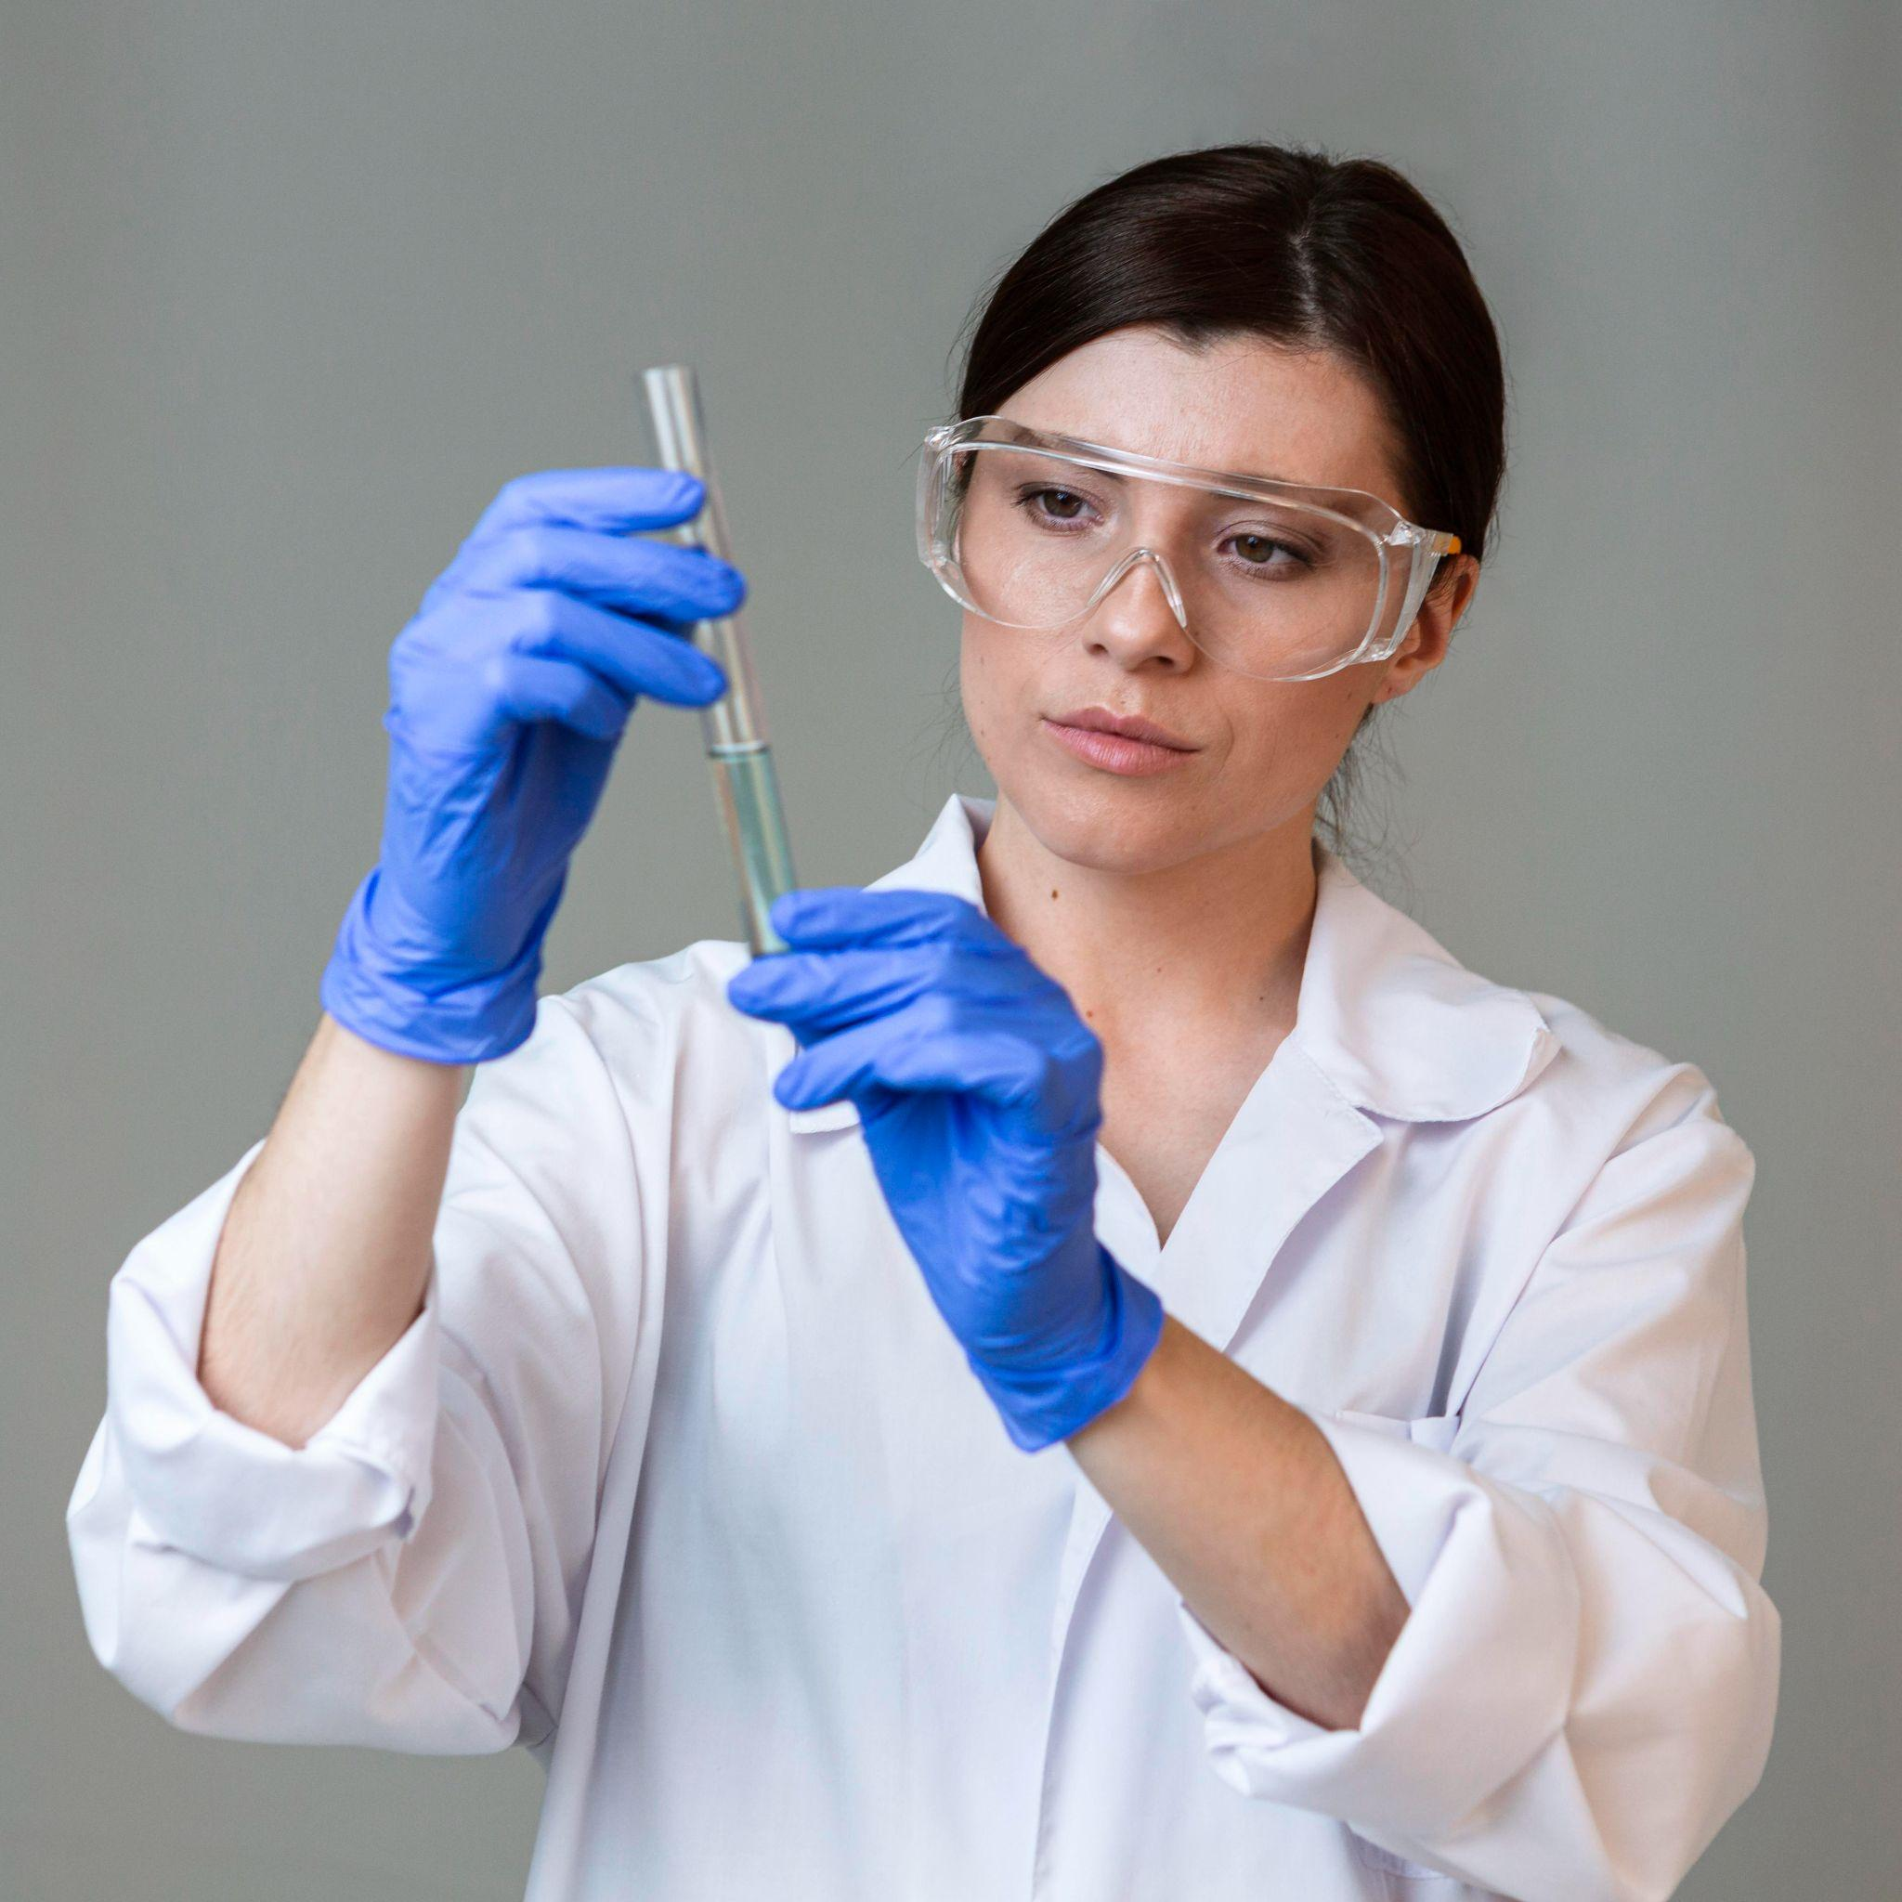
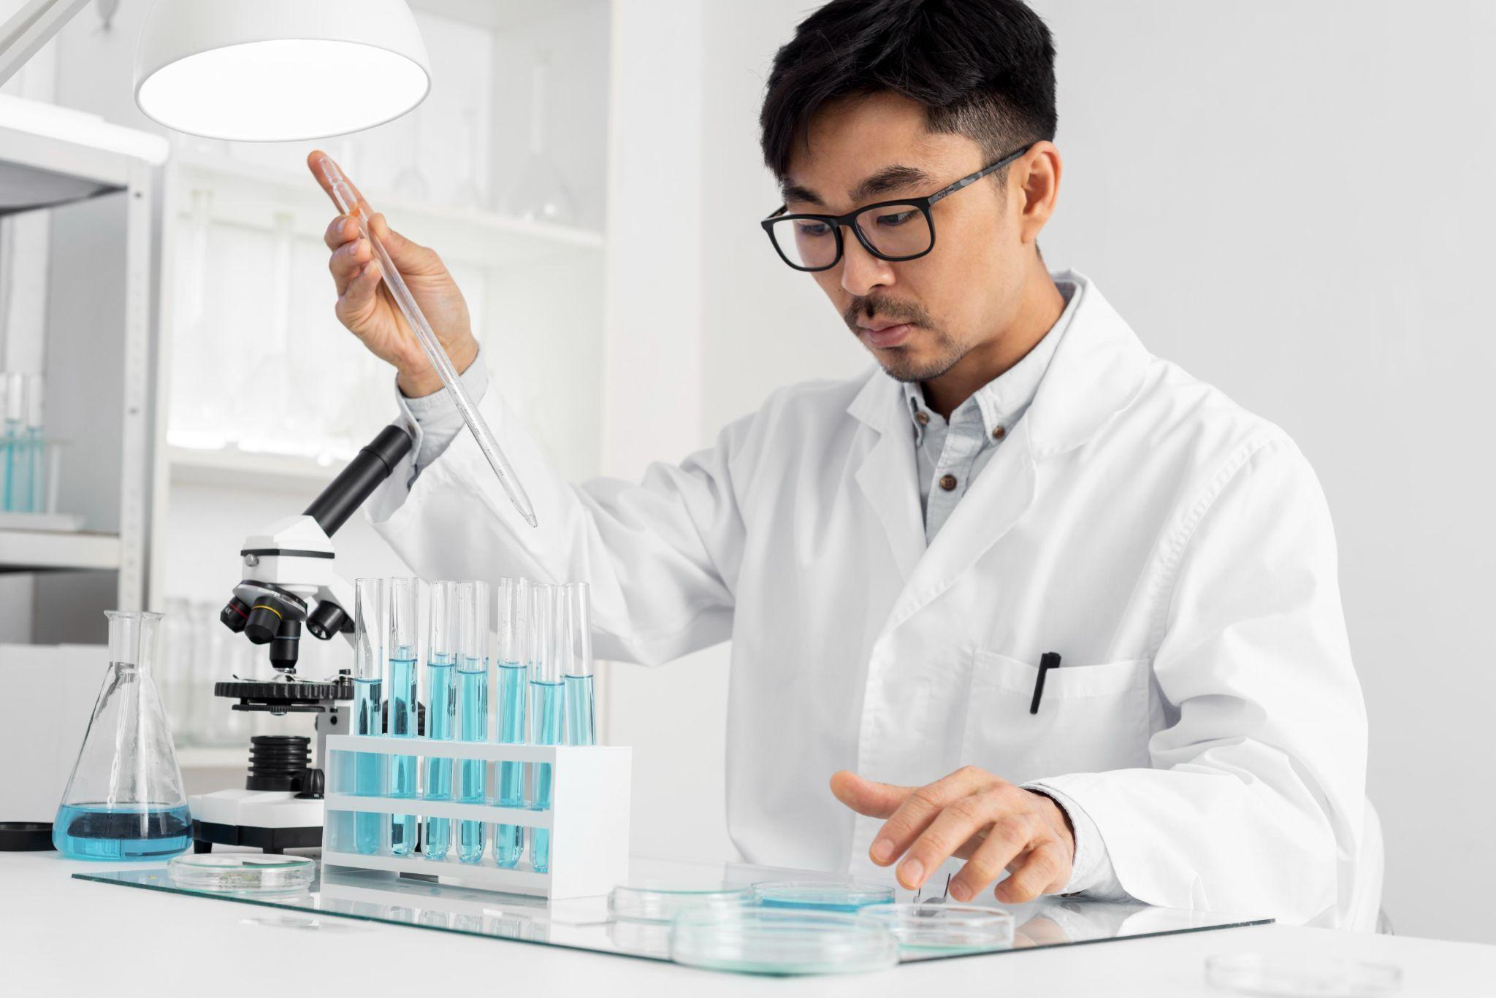
Our team
Curtis Stone
Lena Stewart
Shaun Moyes
You can replace the image on the screen with your own
You can replace the image on the screen with your own
You can replace the image on the screen with your own

Slide 41
Thanks!
Does anyone have any questions?
addyouremail@freepik.com
+91 620 421 838
yourcompany.com
Please keep this slide for attribution

Slide 42





Alternative resources

Slide 43
Alternative resources
Photos:
Close up blurry researcher holding glassware
Front view of female researcher with safety glasses and test tube
Man in lab doing experiments
Man researcher in the laboratory
Vectors:
Gradient background in futuristic style

Slide 44
Resources
Photos:
Close up researcher holding glassware
Front view of female researcher with safety glasses and test tube
Portrait man in lab working or microscope
Smiley man researcher in the laboratory using microscope
Vectors:
Gradient background in futuristic style

Slide 45
Instructions for use
In order to use this template, you must credit Slidesgo by keeping the Thanks slide.
You are allowed to:
- Modify this template.
- Use it for both personal and commercial projects.
You are not allowed to:
- Sublicense, sell or rent any of Slidesgo Content (or a modified version of Slidesgo Content).
- Distribute Slidesgo Content unless it has been expressly authorized by Slidesgo.
- Include Slidesgo Content in an online or offline database or file.
- Offer Slidesgo templates (or modified versions of Slidesgo templates) for download.
- Acquire the copyright of Slidesgo Content.
For more information about editing slides, please read our FAQs or visit Slidesgo School:
https://slidesgo.com/faqs and https://slidesgo.com/slidesgo-school

Slide 46
Instructions for use (premium users)
In order to use this template, you must be a Premium user on Slidesgo.
You are allowed to:
Modify this template.
Use it for both personal and commercial purposes.
Hide or delete the “Thanks” slide and the mention to Slidesgo in the credits.
Share this template in an editable format with people who are not part of your team.
You are not allowed to:
Sublicense, sell or rent this Slidesgo Template (or a modified version of this Slidesgo Template).
Distribute this Slidesgo Template (or a modified version of this Slidesgo Template) or include it in a database or in any other product or service that offers downloadable images, icons or presentations that may be subject to distribution or resale.
Use any of the elements that are part of this Slidesgo Template in an isolated and separated way from this Template.
Register any of the elements that are part of this template as a trademark or logo, or register it as a work in an intellectual property registry or similar.
For more information about editing slides, please read our FAQs or visit Slidesgo School:
https://slidesgo.com/faqs and https://slidesgo.com/slidesgo-school

Slide 47
Fonts & colors used
This presentation has been made using the following fonts:
MuseoModerno
(https://fonts.google.com/specimen/MuseoModerno)
Maven Pro
(https://fonts.google.com/specimen/Maven+Pro)
#000000
#ffffff
#f60863
#11000b
#41046c
#d16d0b

Slide 48





Storyset
Create your Story with our illustrated concepts. Choose the style you like the most, edit its colors, pick the background and layers you want to show and bring them to life with the animator panel! It will boost your presentation. Check out How it Works.
Pana
Amico
Bro
Rafiki
Cuate

Slide 49
Use our editable graphic resources...
You can easily resize these resources without losing quality. To change the color, just ungroup the resource and click on the object you want to change. Then, click on the paint bucket and select the color you want. Group the resource again when you’re done. You can also look for more infographics on Slidesgo.

Slide 52
JANUARY
FEBRUARY
MARCH
APRIL
MAY
JUNE
PHASE 1
Task 1
Task 2
PHASE 2
Task 1
Task 2
JANUARY
FEBRUARY
MARCH
APRIL
PHASE 1
Task 1
Task 2

Slide 55
...and our sets of editable icons
You can resize these icons without losing quality.
You can change the stroke and fill color; just select the icon and click on the paint bucket/pen.
In Google Slides, you can also use Flaticon’s extension, allowing you to customize and add even more icons.

Slide 56
Educational Icons
Medical Icons

Slide 57
Business Icons
Teamwork Icons

Slide 58
Help & Support Icons
Avatar Icons

Slide 59
Creative Process Icons
Performing Arts Icons

Slide 60
Nature Icons

Slide 61
SEO & Marketing Icons

Slide 62


